Slide 1
Azure IaaS

Slide 2
Agenda
Your services and Azure
Virtual Machines
Virtual Networks
Azure Resource Manager

Slide 3
Your service
Notes:
Slide Objectives:
Explain how Azure helps developers to refocus on their applications.
Speaker Notes:
Before we discuss about specifics, let’s refocus on what you care about – your application/service.
Azure is taking a application-centric approach and brings tools and services to support DevOps scenarios.

Slide 4
→ Your application code
→ Your infrastructure code
→ Required resources
Notes:
Slide Objectives:
Explain application is made up by application code and infrastructure code.
Speaker Notes:
Let’s start with something that you know inside-and-out: your application code. [click]
Then, for whatever reason, you decide to deploy your application to Azure. [click]
What you do is to allocate a bunch of related resources out of the humongous resource pool provided by Azure, deploy your application code to these resources, and you have a running service. [click]
For DevOps’ perspective, you need a way to reliable capture and apply your requirements on resources, which can be referred as infrastructure code.

Slide 5
You: Code (application, infrastructure)
Azure: Resources (IaaS, PaaS, SaaS)
Notes:
Slide Objectives:
Reiterate the point that to make your service successful, you are partnering with Azure. You bring the code, and Azure brings resources.
This slide also sets state for the talk by explaining how IaaS components fit into the overall picture.
Speaker Notes:
[Continue with previous slide]
To make your service successful, you are partnering with Azure. You bring the code, and Azure brings resources. [Click]
And you keep iterating and making improvements over time. [Click]
In terms of infrastructure code, you can use it to define desired states of required resources (Note: current Azure Resource Manager only support a small number of Resource Providers). [Click]
You can define hosting environments, such as websites, cloud services and VMs. [Click]
Required services. [Click]
In this session we’ll focus on infrastructural components including virtual machines and virtual networks.

Slide 6
Virtual Machines

Slide 7
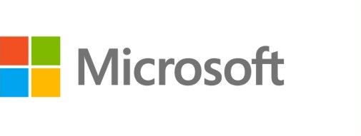



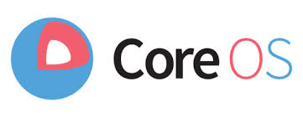

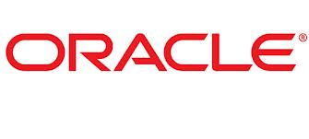
Azure Virtual Machines
Launch Windows Server and Linux in minutes
Scale from 1 to 1000s of VM Instances
Save money with per-minute billing
Open and extensible
Notes:
Slide Objectives:
High-level selling points of virtual machines.
Speaker Notes:
Both Linux and Windows are supported. It’s important to reiterate on this as many developers are still not aware of this.
Mention scaling at enterprise level using DSC, Puppet or Chef.
Emphasize on the openness – we are not forcing your to lock on Microsoft technologies. Instead, Azure is more open than ever. You can leverage your existing skills, tools and services, and Azure is providing more and more first-class supports for them.

Slide 8
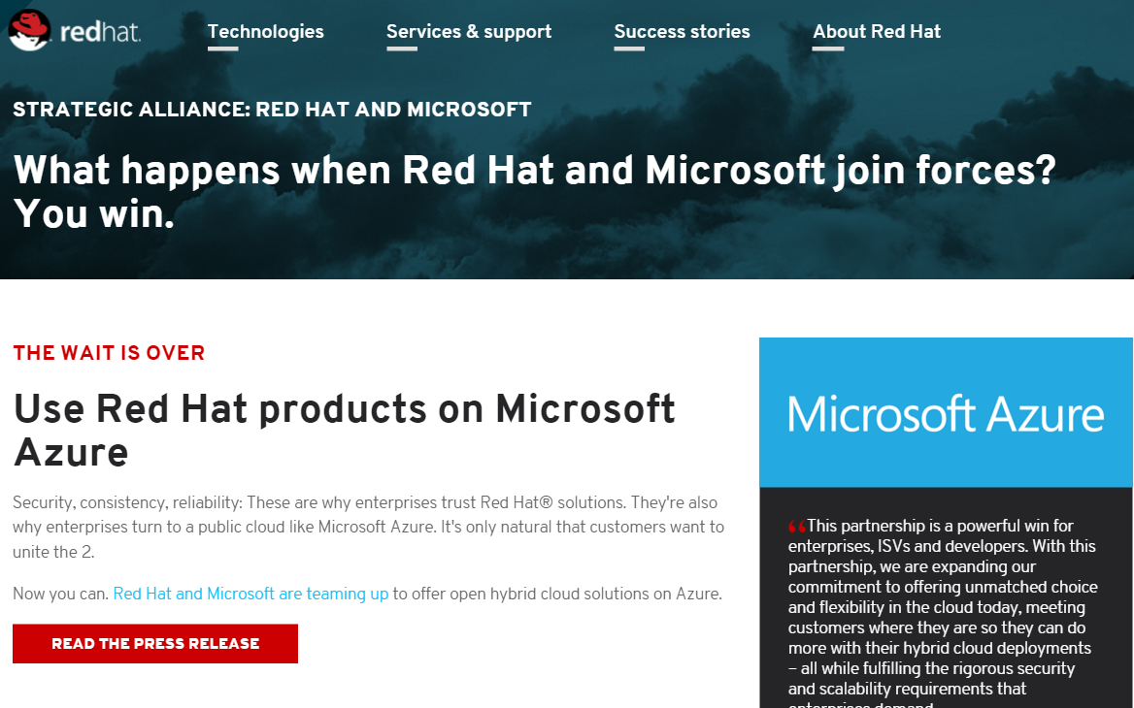
Announcing - now on Azure
Notes:
Slide Objectives:
High-level selling points of virtual machines.
Speaker Notes:
Both Linux and Windows are supported. It’s important to reiterate on this as many developers are still not aware of this.
Mention scaling at enterprise level using DSC, Puppet or Chef.
Emphasize on the openness – we are not forcing your to lock on Microsoft technologies. Instead, Azure is more open than ever. You can leverage your existing skills, tools and services, and Azure is providing more and more first-class supports for them.

Slide 9


Provisioning VM
Getting Started
Select Image and VM Size
New Disk Persisted in Storage
Windows Server
Management Portal
Boot VM from New Disk
Linux
>_
General Purpose
Basic
Standard
Optimized Compute
Performance Optimized
Network Optimized
Scripting
(Windows, Linux and Mac)
Cloud
REST API
Notes:
Slide Objective:
Explain workflow for provisioning VMs in the cloud
Speaker Notes:
You have three methods of starting this process: Build a VM from the portal, from the command line OR programmatically calling the REST API.
Once your choice of provisioning is made you will need to select the image and instance size to start from.
The newly created disk will be stored in blob storage and your machine will boot.

Slide 10









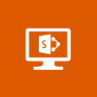







VM Gallery
A collection of prebuilt images for various workloads
Windows Server 2012 R2
Ubuntu Server 14.04 LTS
CentOS 6.5
SUSE Linux
Enterprise Server
openSUSE 13.1
Oracle Linux 6.4.0.0.0
SQL Server 2014 Standard
Oracle Database 11g R2
SharePoint Server Farm
Microsoft Dynamics
GP 2013
Zulu 8
BizTalk Server 2013
SAP HANA
Developer Edition
Puppet Enterprise 3.2.3
Barracuda Web Application
Oracle WebLogic
Server 12.1.2
Visual Studio Ultimate 2013
Windows 8.1 Enterprise
Notes:
Slide Objective:
Explain a wide variety of images that you can choose from.
Speaker Notes:
First of all, you can choose from different Windows Servers and a variety of Linux implementations. [Click]
As well as pre-built images for different flavors of SQL Database and Oracle databases. [Click]
You can also choose from a number of first-party and certified third-party images for various application servers and infrastructural components. [Click]
And last but not least, if you are a MSDN subscriber, you also have access to Visual Studio images and client Windows systems such as Windows 7 and Windows 8.1 for your DevTest purposes.

Slide 11
Virtual Machine Sizess
General Purpose compute: Basic
General Purpose compute: Standard
Optimized Compute
Performance Optimized
Network Optimized
Notes:
Slide Objective:
Introduce different virtual machine sizes.
Speaker Notes:
http://azure.microsoft.com/en-us/pricing/details/virtual-machines/

Slide 12
Scale-up options
Highest value
Largest scale-up
A
D
G
N
DV2
Highest value
Most memory fastest CPUs
GPU-enabled virtual machines
SSD Storage Fast CPUs
>80,000 IOPs
Premium Storage
New generation of D family VMs
35% faster than D
Intel E5-2673 v3 CPUs
NVIDIA GPUs
Remote visualization
Compute-intensive + RDMA
Largest virtual machines Fastest storage in the public cloud

Slide 13
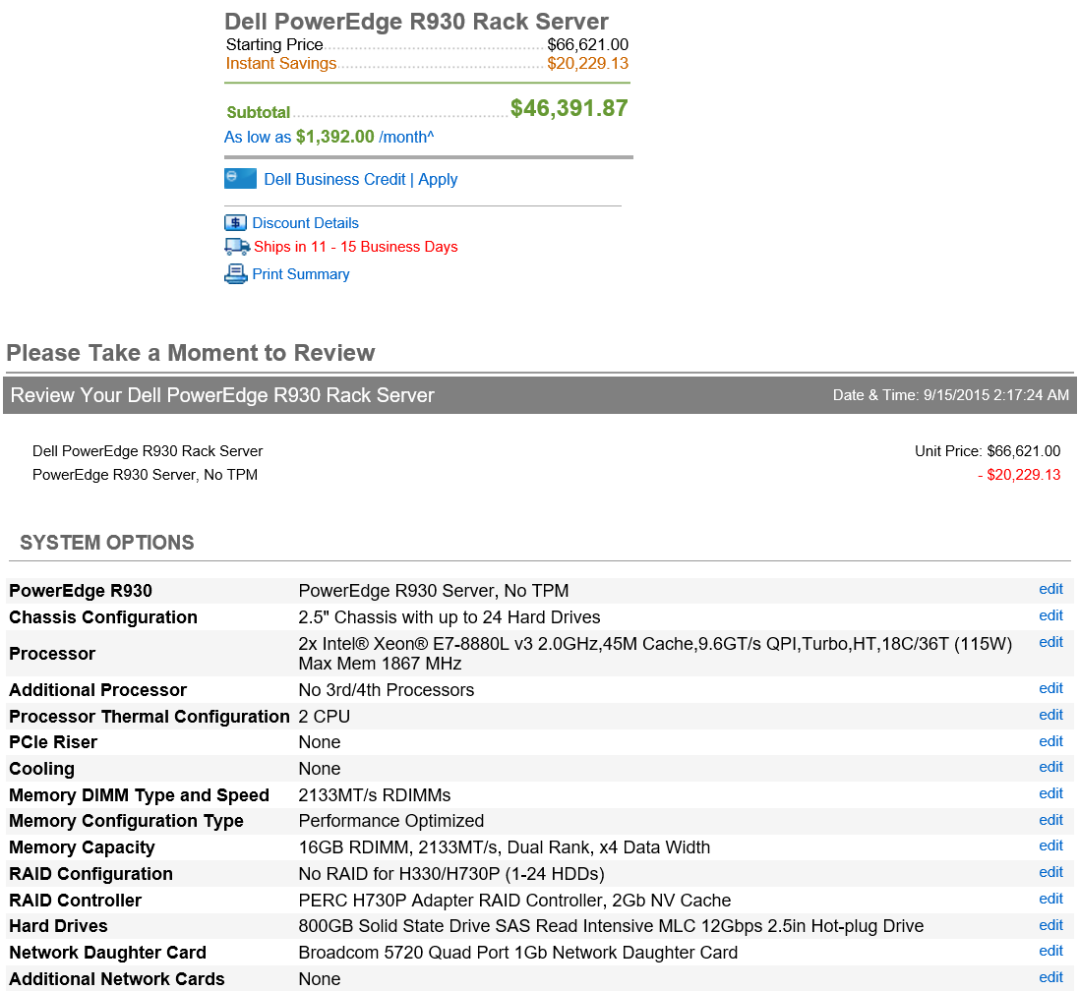
The G family
G
Optimized for data workloads
Up to 32 CPU cores, 448 GB RAM
6.5 TB local SSD
Latest generation Intel processor
Up to 64 attached disks!!
Notes:
https://azure.microsoft.com/en-us/pricing/details/virtual-machines/#Windows

Slide 14
General Purpose Compute
Basic Tier
An economical option for development workloads, test servers, and other applications that don't require load balancing, auto-scaling, or memory-intensive virtual machines.
Instance | Cores | RAM | Disk sizes
A0 | 1 | 0.75 GB | 20 GB
A1 | 1 | 1.75 GB | 40 GB
A2 | 2 | 3.5 GB | 60 GB
A3 | 4 | 7 GB | 120 GB
A4 | 8 | 14 GB | 240 GB

Slide 15
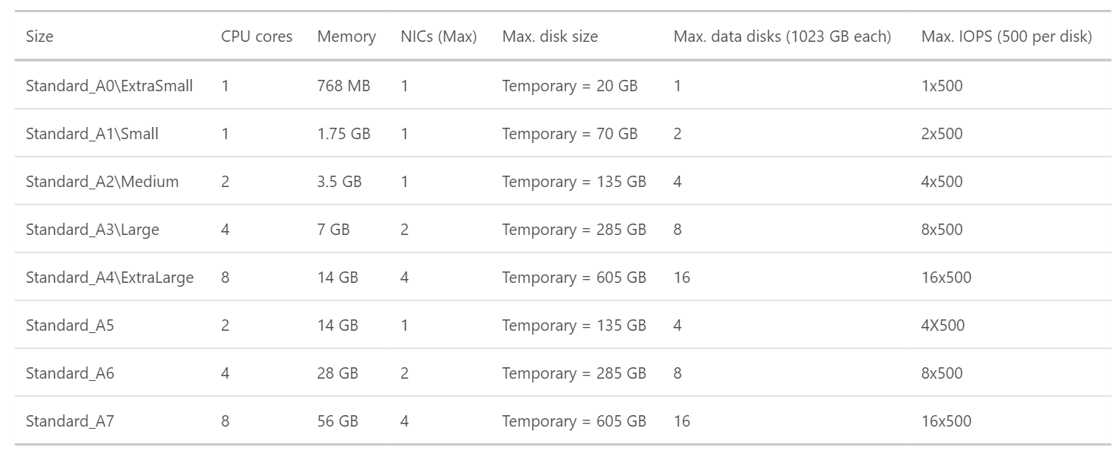
General Purpose Compute
Standard Tier
Offers the most flexibility. Supports all virtual machine configurations and features

Slide 16
General Purpose Compute
Network optimized with Infiniband support
Adds a 40Gbit/s InfiniBand network with remote direct memory access (RDMA) technology.
Instance | Cores | RAM | Disk sizes
A8 | 8 | 56 GB | 382 GB
A9 | 16 | 112 GB | 382 GB
Adds a 40Gbit/s InfiniBand network with remote direct memory access (RDMA) technology. Ideal for Message Passing Interface (MPI) applications, high-performance clusters, modeling and simulations, video encoding, and other compute or network intensive scenarios.
Notes:
This article provides background information and considerations for using the Azure A8, A9, A10, and A11 instances, also known as compute-intensiveinstances. Key features of these instances include:
High-performance hardware – The Azure datacenter hardware that runs these instances is designed and optimized for compute-intensive and network-intensive applications, including high-performance computing (HPC) cluster applications, modeling, and simulations.
RDMA network connection for MPI applications – When configured with the necessary network drivers, the A8 and A9 instances can communicate with other A8 and A9 instances over a low-latency, high-throughput network in Azure that is based on remote direct memory access (RDMA) technology. This feature can boost the performance of applications that use supported Linux or Windows Message Passing Interface (MPI) implementations.
Support for Linux and Windows HPC clusters – Deploy cluster management and job scheduling software on the A8, A9, A10, and A11 instances in Azure to create a stand-alone HPC cluster or to add capacity to an on-premises cluster. Like other Azure VM sizes, the A8, A9, A10, and A11 instances support standard or custom Windows Server and Linux operating system images or Azure Resource Manager templates in Azure VMs (IaaS), or Azure Guest OS releases in cloud services (PaaS, for Windows Server only).
NOTE:
A10 and A11 instances have the same performance optimizations and specifications as the A8 and A9 instances. However, they do not include access to the RDMA network in Azure. They are designed for HPC applications that do not require constant and low-latency communication between nodes, also known as parametric or embarrassingly parallel applications.

Slide 17
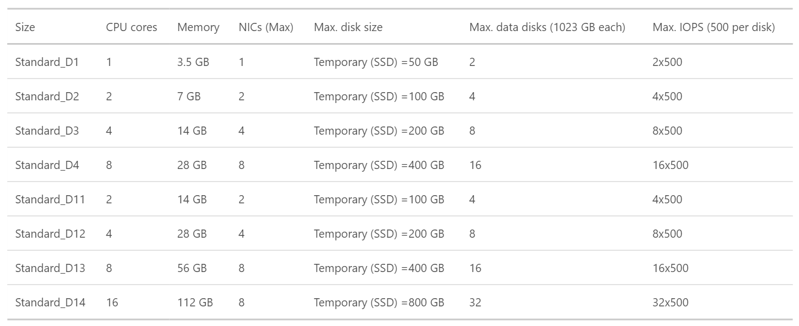
Optimized Compute (D Tier)- 60% faster CPUs, more memory, and local SSD

Slide 18
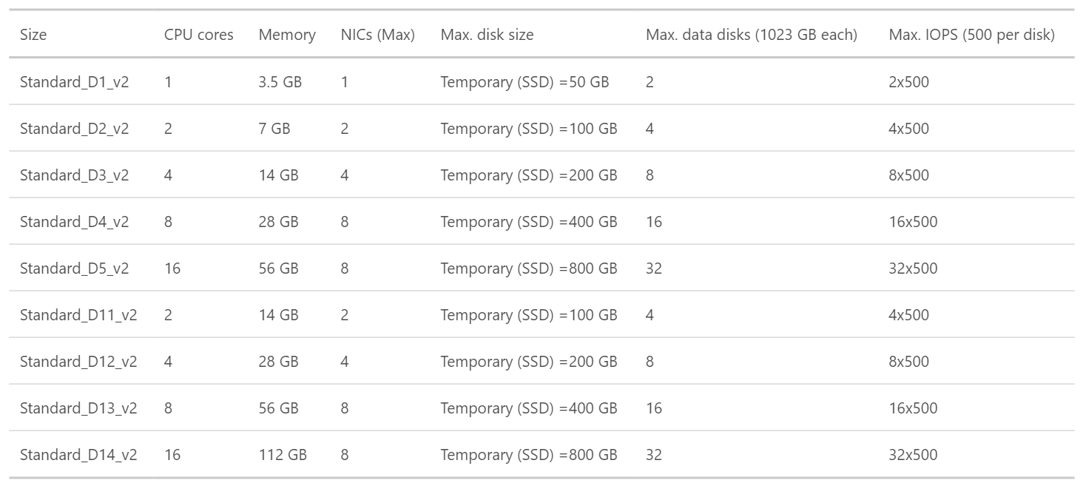
Dv2 Series- 35% faster than D series, 2.4 GHz Intel Xeon® E5-2673 v3 (Haswell) processor
Notes:
Dv2-series, a follow-on to the original D-series, features a more powerful CPU. The Dv2-series CPU is about 35% faster than the D-series CPU. It is based on the latest generation 2.4 GHz Intel Xeon® E5-2673 v3 (Haswell) processor, and with the Intel Turbo Boost Technology 2.0, can go up to 3.2 GHz. The Dv2-series has the same memory and disk configurations as the D-series.

Slide 19
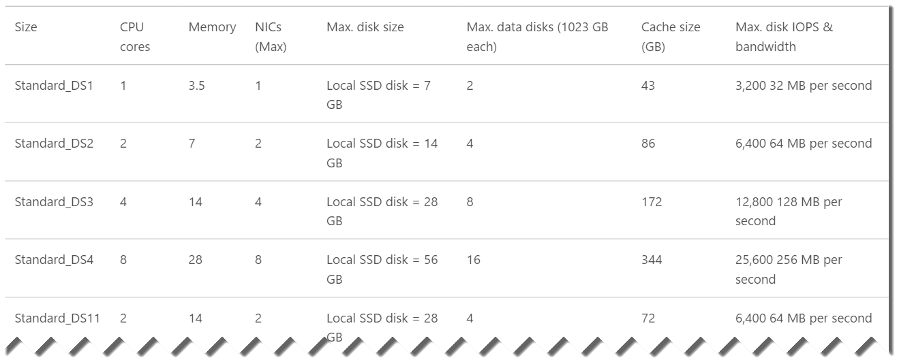
DS-series VMs can use Premium Storage- high-performance, low-latency storage.
Notes:
DS-series and GS-series VMs can use Premium Storage, which provides high-performance, low-latency storage for I/O intensive workloads. These VMs use solid-state drives (SSDs) to host a virtual machine’s disks and also provide a local SSD disk cache. Premium Storage is available in certain regions.

Slide 20
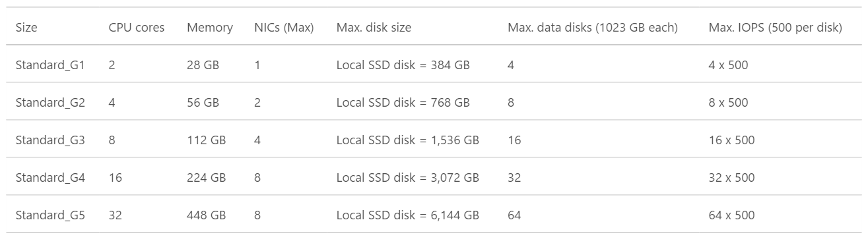
G-series VMs offer the most memory and run on hosts that have Intel Xeon E5 V3 family processors.

Slide 21
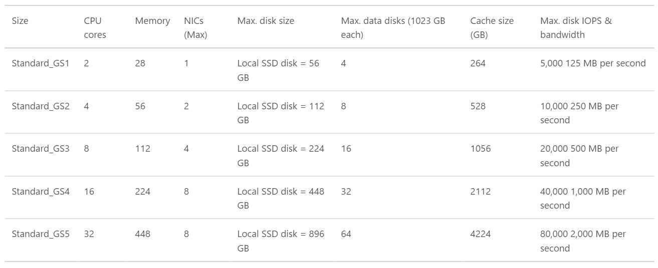
GS-series VMs , Godzilla ++ (Premium Storage- high-performance, low-latency storage for I/O intensive workloads.)

Slide 22
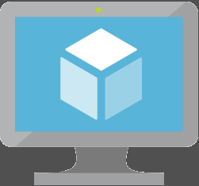
Key Improvements: Azure Virtual Machines (v2)
Massive and parallel deployment of Virtual Machines
3 Fault Domains in Availability Sets
Custom URLs for Custom Script VM Extensions for VMs
https://azure.microsoft.com/en-us/documentation/articles/virtual-machines-app-frameworks/

Slide 23
NEW: VM Scale Sets

Slide 24
Virtual Machine Scale Sets
“Next-Generation Worker Role”
Supports Windows, Linux, and custom images
Stateless and persistent disks
Image-based OS patching
Ideal for clusters
Notes:
The VMs just discussed are single instance VMs. You need to perform Installation and configuration in each VM you provision, making scaling up and down a manual process. VM Scale Sets are a group of identical VMs based on the same image that can be scaled based on a set of rules. This is comparable to the way Cloud Service Web Roles and Worker Roles work, but with some key difference.
VM Scale Sets support both Windows and Linux.
You can make use of persistent disks to store data on the VM, although auto scaling implies stateless environments.
VMs are based on images and updates must be done in the image or with automation.
VM Scale Sets are ideal for clusters such as a farm of webservers, because the Scale Set automatically scales up and down as the load changes.

Slide 25
NEW: Application Gateway

Slide 26
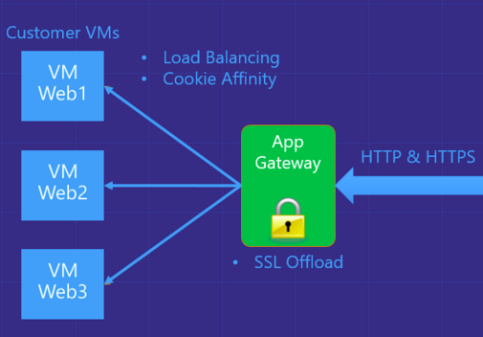
Azure Application Gateway
Azure-managed, first party virtual appliances
HTTP routing based on app-level policies
Cookies affinity
URL hash
SSL termination and caching
Notes:
Application load balancing enables IT administrators and developers to create routing rules for network traffic based on HTTP.
Application Gateway currently supports layer 7 application delivery for the following:
HTTP load balancing
Cookie based session affinity
SSL offload
HTTP layer 7 load balancing:
Azure provides layer 4 load balancing via Azure load balancer working at the transport level (TCP/UDP) and having all incoming network traffic being load balanced to the Application Gateway service. The Application Gateway then will apply the routing rules to HTTP traffic, providing level 7 (HTTP) load balancing. When you create an application gateway, an endpoint (VIP) will be associated and used as public IP for ingress network traffic.
HTTP layer 7 load balancing is useful for:
Applications that require requests from the same user/client session to reach the same back-end VM. Examples of this would be shopping cart apps and web mail servers.
Applications that want to free web server farms from SSL termination overhead.
Applications, such as CDN, that require multiple HTTP requests on the same long-running TCP connection to be routed/load balanced to different backend servers.

Slide 27
VMs + Containers

Slide 28
Containers
App
A
App
A
App
B
What are they?
Unit of deployment
Isolated environment
Isolated collection of resources
What are the benefits?
Instant startup
Repeatable and reliable execution
Scenarios
Dev/Test
Great for micro-services
App
Framework
App
Framework
App
Framework
VM
Host OS
Guest OS
Guest OS
Guest OS
Hypervisor
Physical Server
App
A
App
A
App
B
App
B
App
B
Container
Container Manager
App
Framework
App
Framework
Host OS
Physical Server
Notes:
When you see “containers” you probably think of Docker. For good reason, Docker has essentially defined the container market. To understand what Docker is let’s start by looking at Containers.
Containers are an isolated environment and isolated collection of resources that an application runs in. The resources are all the dependencies (DLL’s, configuration, etc.) that the application needs. Everything the application needs to run is in the container and it sees nothing on the host OS it is running on (except maybe an internet connection). Containers are therefore a unit of deployment.
<click>
A key benefit of containers is that they can startup almost instantly. The notion of “booting up” a guest OS doesn’t exist. The container just runs on top of the host OS. As a result, containers can startup almost instantly as compared to the startup period of a VM. And because everything is contained in this container, containers are easily repeatable and extremely reliable from one environment to the next. For example, I can run a container on my local dev box and have high confidence it will run the same when deployed to another machine, such as a VM running in Azure.
<Click>
As you can probably imagine, containers are extremely popular in dev/test scenarios. They are also great for micro-services.
<click>
To put a visual behind this, consider the architecture for a typical virtual machine. You have a physical server, hyper-visor and host OS. Then, each VM has it’s own guest OS that can be configured with applications and application frameworks. This is what you saw earlier in the presentation.
<click>
Now consider how a container is different. Physical Server with a host OS. However, notice there is not a guest OS. The container is essentially the application and it’s dependencies. Also notice that the app frameworks used by application A and application B are shared in this model. This is how instant startup is achieved.
Note that there are more instances of the same App running on the physical server. This underlines that a container is a scale unit besides being an isolation mechanism. In a production development you would use a cluster of hosts, and have containers spread of the hosts.

Slide 29


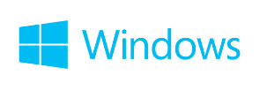
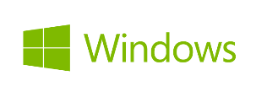
Container Ecosystem via Docker
Container Run-Time
Container Images
Image Repository
Linux
Docker API / Client
Docker images
Docker Hub
(trusted repositories)
Notes:
Docker has also pretty-much defined the container ecosystem (de-facto standard). It provides the means for deploying these containers and resources onto a machine by developing a Docker API that drives these activities.
The container runtime traditionally only ran on Linux VM’s. However, today, Windows Server 2016 provides a new “Container Role” (similar to other roles like AD, File Server, etc.) that you can configure on Windows. This provides the same abilities to create and manage containers that exists on Linux.
<Click>
Docker has also become the standard for defining what a container image looks like. The file format, the manifest that goes into the container, and how image dependencies are configured. And Windows and .NET are perfectly valid candidates for a Docker image.
<Click>
Docker has become the standard place for people to publish their images. Docker Hub is a public “trusted repository” where you can find literally thousands of Docker images such as Apache, MySQL, and even .NET.
Microsoft Azure embraces this container technology and has integrated it directly into the platform.

Slide 30
Demo: Managing VMs using Azure portal
Notes:
Demo: Provisioning VM
Prerequisites:
A Windows Server 2012 is already provisioned.
Steps:
Open Ibiza portal and click the NEW button at the lower-left corner.
Show the short list of resources. Explain that I can directly create popular resources here such as a Windows Server 2012.
Click on the Everything link.
In Gallery blade, open the Virtual machines category.
Scroll down the view and show images of different types (refer back to slide 9).
Click on Windows Server 2012 R2, and then click the Create button in the overview blade. For non-Microsoft focused audience, consider to pick a Linux image instead.
Fill in the Create VM form and click on the Create button to provision the VM. Explain this will take a few minutes.
Open the already provisioned VM.
Scroll down the blade to show various of information available on the blade.
Click on the Extensions tile.
On the Extensions blade, click on the ADD icon to bring up the extension list. Introduce that VM extensions are installable components to customize VM instances.
Switch to slides to continue with VM extension introduction.

Slide 31
Image Mobility
On-Premises
Cloud
MyApp.vhd
Notes:
Slide Objective:
Explain the benefits of image mobility
Notes:
One of the key benefits of IaaS is flexibility and control. The Microsoft Azure solution provides the capability of not only moving VHDs TO the cloud but also allows you to copy the VHD back down and run it locally or on another cloud provider. Great for testing out production issues or any other need where you require a copy of the production server.

Slide 32

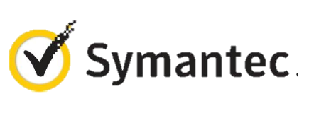

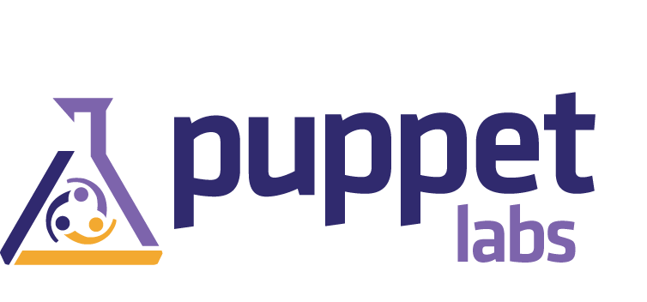


VM Extensions
Installable components to customize VM instances
Enable various DevOps scenarios
Can be added, updated, disabled or removed at any time
Managed via portal, PowerShell and Management APIs
Microsoft Azure
Notes:
Slide Objective:
Introduce VM extensions.
Speaker Notes:
No matter how big the image gallery is, your projects may have specific needs that can’t be satisfied by standard images.
Some components such as anti-virus, configuration management agents are required on most machines for compliance and management purposes.
This allows use to innovate faster to meet with your project needs. And you have flexibility to pick and combine extensions for your goals.
Point out some of existing extensions:
Custom Script Extension, which allows you to download and execute PowerShell scripts.
Chef Extension and Puppet Extension for automated management at scale.
Symantec Endpoint Protection etc. for protection.
Docker (Linux only).
Visual Studio Remote Debugger.

Slide 33
Demo: Add an extension to a VM instance
Notes:
Demo: VM Extension
Prerequisites:
Azure PowerShell v0.8 or higher has been installed and configured.
Desired Azure subscription has already been selected.
A storage account has been provisioned under the same Azure subscription.
A scripts container has been created under the storage account with public read access.
A helloworld.ps1 PowerShell script has been uploaded to the container. The content of the script is a single line: write-output “Hello World!”
PowerShell environment has been set with large font for easy reading.
A Windows Server 2012 VM has been provisioned.
Steps:
In Azure PowerShell, issue command: Get-AzureVMAvailableExtension | Format-Table -Property ExtensionName, Publisher
The above cmdlet lists existing extensions. Next we’ll see how we can inject an extension to a running VM instance. In the last demo you’ve seen that you can achieve this using Azure Management Portal. Here we’ll do it using PowerShell. In this case, we’ll install Custom Script Extension to an existing Windows Server 2012 VM.
Issue the following cmdlets to get a reference to the virtual machine instance:
$serviceName = “[cloud service that hosts the VM]”
$vmName = “[name of the VM]”
$vm = Get-AzureVM –ServiceName $serviceName –Name $vmName
Next, issue command Get-AzureVMExtension –VM $vm. This lists VM extensions that are currently installed on the VM.
Use the following cmdlet to enable Custom Script Extension, and instruct it to download and execute the helloworld.ps1 (this takes about 20-30 seconds):
Set-AzureVMCustomScriptExtension -ContainerName scripts -StorageAccountName '[your storage account name]' -VM $vm -FileName ‘helloworld.ps1' -Run ‘helloworld.ps1' | Update-AzureVM -Verbose
6. Next, we’ll retrieve and display the script execution result:
$status = Get-AzureVM -ServiceName $serviceName -Name $vmName
$result = $status.ResourceExtensionStatusList.ExtensionSettingStatus.SubStatusList | Select Name, @{"Label"="Message";Expression = {$_.FormattedMessage.Message }}
$result |fl
(see screenshots in hidden slides for references)
(see this blog: http://azure.microsoft.com/blog/2014/07/15/automating-sql-server-vm-configuration-using-custom-script-extension/ for more details on Custom Script Extension)

Slide 34
Data Persistence
OS Disks
Data Disks

Slide 35
Disks and Images
OS Images
Microsoft
Partner
User
Base OS image for new Virtual Machines
Sys-Prepped/Generalized/Read Only
Created by uploading or by capture
Disks
OS Disks
Data Disks
Writable Disks for Virtual Machines
Created during VM creation or during upload of existing VHDs.
Notes:
Slide Objective:
Explain the differences between disks and images with VMs

Slide 36
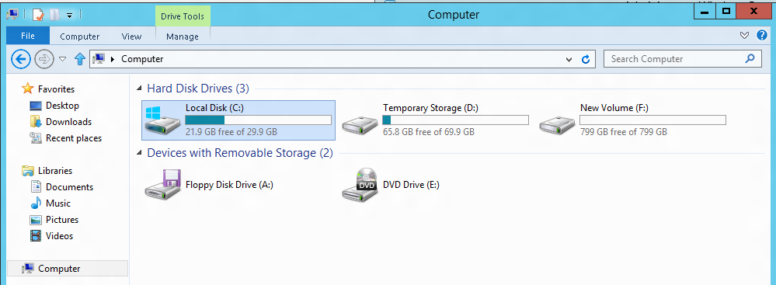
VM disk layout
OS Disk
Persistent
SATA
Drive C:
Temporary Storage Disk
Local (Not Persistent)
SATA
Drive D:
Data Disk(s)
Persistent
SCSI
Customer Defined Letter

Slide 37
Temporary Drive Guidance
Never Place Critical Unreplicated Data on Temp Drive!!
Use for SQL TempDB and Buffer Pool Extension on D-Series and G-Series VM Sizes Only (SSD Temp Disks)
Detailed instructions: http://blogs.technet.com/b/dataplatforminsider/archive/2014/09/25/using-ssds-in-azure-vms-to-store-sql-server-tempdb-and-buffer-pool-extensions.aspx
Use Scheduled Tasks to Configure Temporary Disk
Test Scheduled Tasks via Resize VM Operation

Slide 38
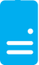
Persistent Disks and Highly Durable
Microsoft Azure Storage (Disaster Recovery)
Microsoft Azure Storage
Virtual
Machine
Virtual Machine
Notes:
Slide Objective:
Explain how disks are durable and how Microsoft Azure storage works
Notes:
The OS and Data Disks are stored in Microsoft Azure storage. So in addition to the data being persistent you also get the benefits of storage which means your VHD is replicated 3X’s locally and also 3X’s in a separate data center in the same region (geo-replication)

Slide 39
Linux on the
Microsoft Cloud Platform

Slide 40
Microsoft Linux

Slide 41
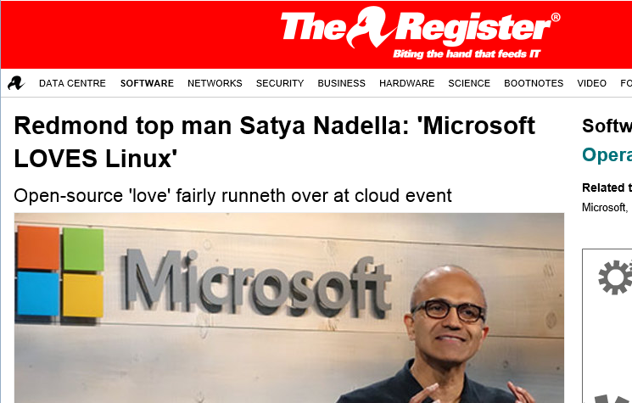
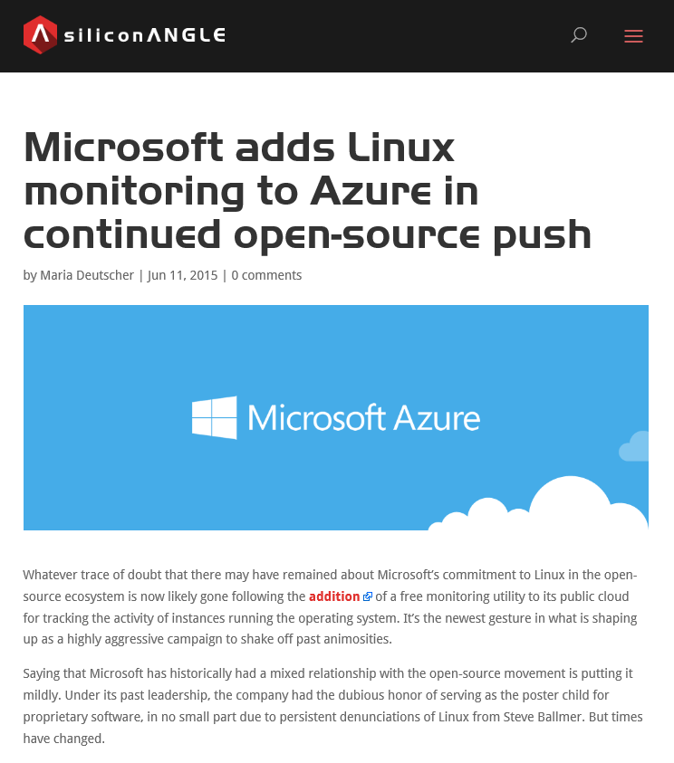
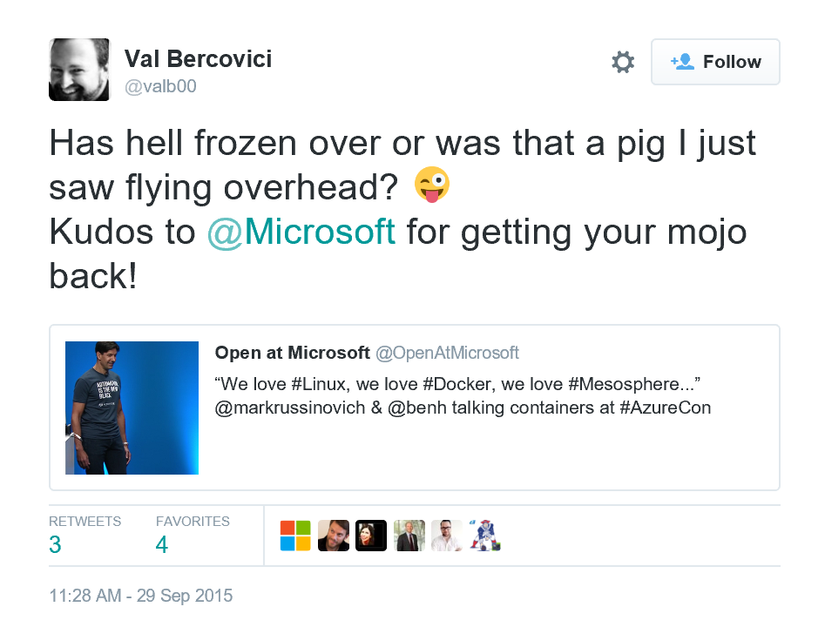
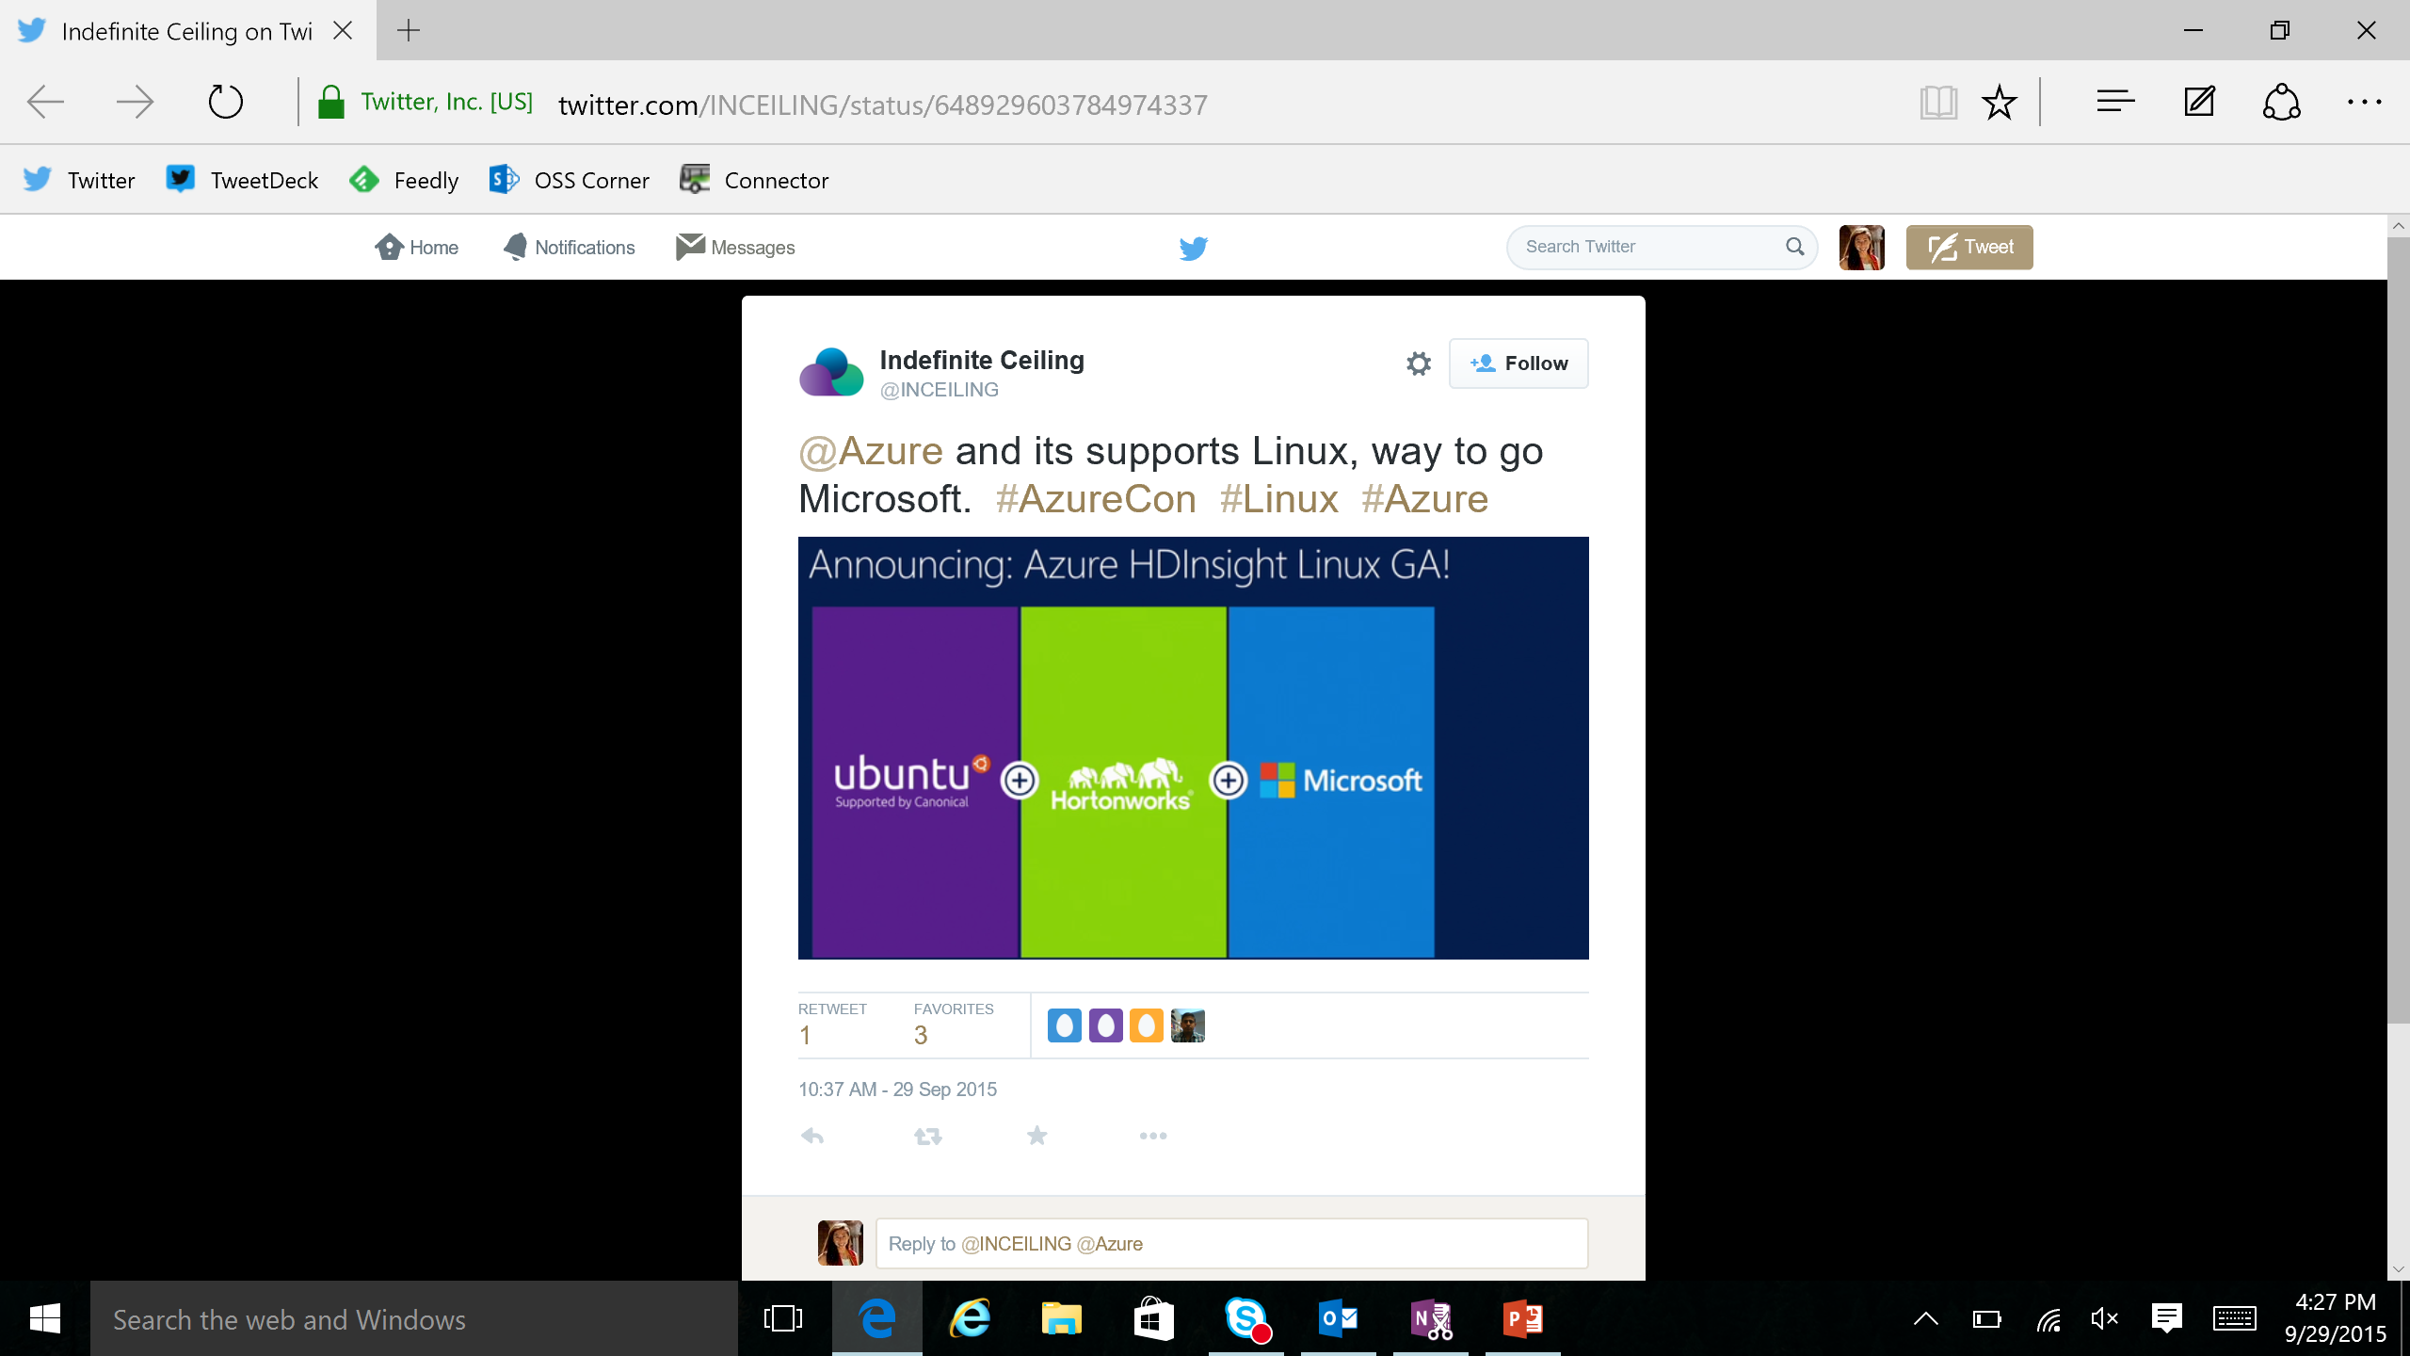
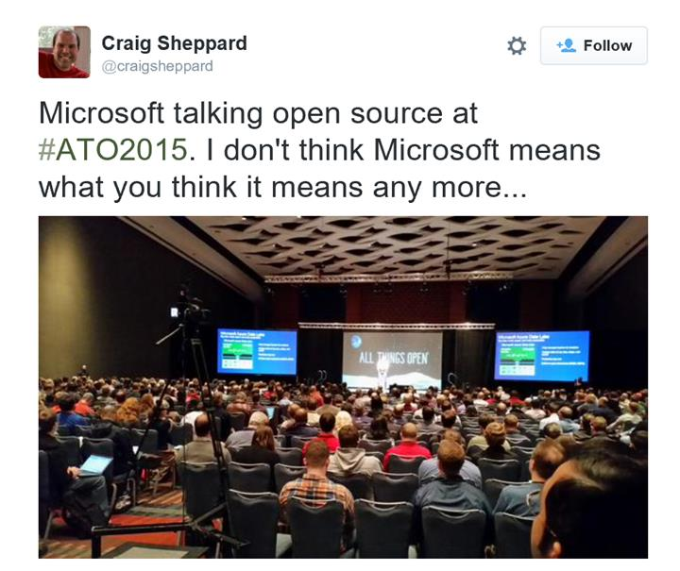
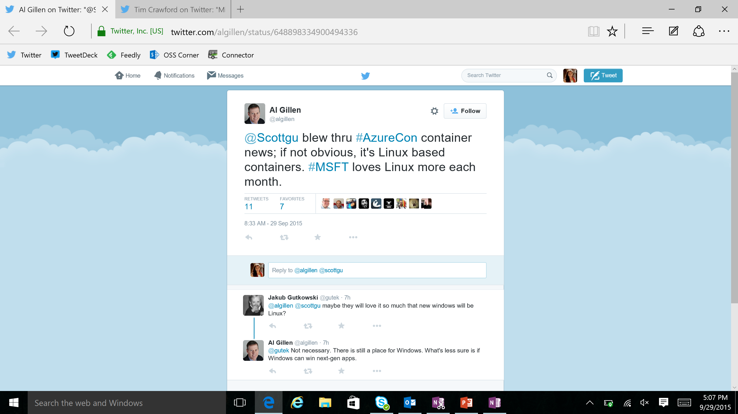

Slide 42
Microsoft is committed to Linux and open source
Linux is a real business for Microsoft
25% of IaaS VMs in Azure are Linux
System Center manages hundreds of thousands of Linux/UNIX servers
Many enterprises and service providers
run Linux as a guest on Hyper-V
… and we’re been in a long open source journey!
System Center has managed Linux and
UNIX servers since 2009
Linux drivers for Hyper-V available since 2010
Azure IaaS has run
Linux VMs since
“day 1” in 2013
Linux and open source are a fundamental part of how we do business
Today

Slide 43
Virtual Machine Availability
Meaning of 9’s
Fault domains, update domains and availability sets
Load balancing

Slide 44
Meaning of 9’s
Service Availability(%) | System Type | Annualized Down Minutes | Quarterly Down Minutes | Monthly Down Minutes | Practical Meaning | FAA rating
90 | Unmanaged | 52,596.00 | 13,149.00 | 4,383.00 | Down 5 weeks per year
99 | Managed | 5,259.60 | 1,314.90 | 438.30 | Down 4 days per year | ROUTINE
99.9 | Well managed | 525.96 | 131.49 | 43.83 | Down 9 hours per year | ESSENTIAL
99.99 | Fault tolerant | 52.60 | 13.15 | 4.38 | Down 1 hour per year
From Generic Requirements for Operation Systems Platform Reliability, Telcordia Technologies System Documentation,GR-2841-CORE and
Federation Aviation Administration Handbook: Reliability, Maintainability, and Availability (RMA) Handbook, FAA-HDBK-006A, Jan 7, 2008.
Microsoft Azure
Notes:
Routine or Essential – an Ecommerce website, no lives depend on you, but you may lose money if you’re down. Then again, if you’re Amazon…

Slide 45
Meaning of 9’s
Service Availability(%) | System Type | Annualized Down Minutes | Quarterly Down Minutes | Monthly Down Minutes | Practical Meaning | FAA rating
99.999 | High availability | 5.26 | 1.31 | 0.44 | Down 5 minutes per year | CRITICAL
99.9999 | Very high availability | 0.53 | 0.13 | 0.04 | Down 30 seconds per year
99.99999 | Ultra availability | 0.05 | 0.01 | - | Down 3 seconds per year | SAFETY CRITICAL
From Generic Requirements for Operation Systems Platform Reliability, Telcordia Technologies System Documentation,GR-2841-CORE and
Federation Aviation Administration Handbook: Reliability, Maintainability, and Availability (RMA) Handbook, FAA-HDBK-006A, Jan 7, 2008.
Microsoft Azure
Notes:
Amazon is not Safety Critical. ADT or the Fire Department might be!

Slide 46

Service Level Agreements
99.95% for multiple role instances
4.38 hours of downtime per year
What’s included
Compute Hardware failure (disk, CPU, memory)
Datacenter failures - Network failure, power failure
Hardware upgrades, Software maintenance – Host OS Updates
What is not included
VM Container crashes, Guest OS Updates

Slide 47

Availability Sets
Availability set
SLA High Availability
Hardware and Software
Windows and Linux
Virtual Machine
Virtual Machine
SQL Server
Primary
SQL Server
Secondary
SLA 99.95

Slide 48
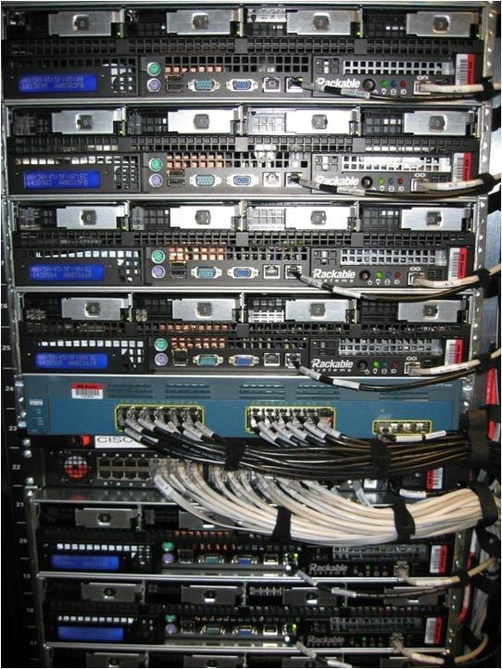
Availability Sets
Physical Machines
Power Unit
Rack Switch

Slide 49

Availability Sets
Physical Machines
Power Unit
Rack Switch
VM1
VM2
VM2
VM1
VM2
Availability Set

Slide 50
Fault and Update Domains
Fault Domain
Fault Domain
Rack
Rack
Web Role
UD #1
UD #2
INSTANCE
INSTANCE
INSTANCE
INSTANCE
Worker Role
UD #1
UD #2
INSTANCE
INSTANCE
INSTANCE
INSTANCE
Notes:
Slide Objective:
Provide a graphical view of fault and upgrade domains for existing web and worker roles. Use to contrast existing skills with availability sets.
Notes:
You can see that our service is well spread out across both fault and upgrade domains
The loss of a fault domain will not cause a failure of our service nor will the restart or change of an upgrade domain cause a failure of our service
Notes
Useful pre-reading here.
http://blog.toddysm.com/2010/04/upgrade-domains-and-fault-domains-in-windows-azure.html

Slide 51
Virtual Machine Availability Sets
Update Domains are honored by host OS updates
Fault Domain
Fault Domain
Rack
Rack
Availability Set
Virtual Machine
Virtual Machine
IIS1
IIS2
UD #1
UD #2
Availability Set
Virtual Machine
Virtual Machine
SQL1
SQL2
UD #1
UD #2
Notes:
Slide Objective:
Explain availability sets
Notes:
Availability sets tell the Fabric Controller to place VMs in the same set on different racks for faults and in separate upgrade domains for updates.
This essentially tells the FC not to take the guest OS down of all VMs in the same set for host updates.

Slide 52
Availability Set Guidance
VMs in Availability Set Must Be in Same Resource Group
Availability Set: 5 Update Domains, 3 Fault Domains
Update Domain – Host Maintenance
Fault Domain – Isolation from component failure in rack unit
Maximum of 100 VMs in a Availability Set
Avoid Availability Sets with Single VM
This eliminates notification for host maintenance operations
https://azure.microsoft.com/en-us/documentation/articles/azure-subscription-service-limits/

Slide 53
Load balancing
Load balancing
Multiple VMs share the workload via public facing endpoints
Internal Load balancing
Load balancing between VMs that don’t have public facing endpoints
Microsoft Azure
Internet
Public VIP
Customer vNet
External Load Balancer
Internal Load Balancer
Microsoft Azure
Back end
Front end

Slide 54
Traffic Manager
Load balancing
Failover
US West
North Europe
Microsoft Azure
North America
Europe

Slide 55

Transform the datacenter Orchestrated disaster recovery to a second site
Microsoft Azure Hyper-V Recovery Manager
Communication Channel
Replication channel: Hyper-V Replica
Windows Server
Primary Site
Recovery Site
Windows Server

Slide 56
Transform the datacenter Orchestrated disaster recovery to a second site or to Azure
Microsoft Azure Site Recovery
Microsoft Azure Site Recovery
Communication Channel
Communication and Replication
Replication channel: Hyper-V Replica
Windows Server
Primary Site
Recovery Site
Windows Server
Primary Site
Windows Server
Key features include:
Automated VM protection and replication
Remote health monitoring
Customizable recovery plans
No-impact recovery plan testing
Orchestrated recovery when needed
Notes:
Speaker Note:
Consider this demo if time permits:
https://microsoft-my.sharepoint.com/personal/mmcspirt_microsoft_com/Documents/Shared%20with%20Everyone/BCDR
The specific demo is Azure Site Recovery – Between Sites.exe

Slide 57


Microsoft Azure Key Vault
Key Vault offers an easy, cost-effective way to safeguard keys and other secrets used by cloud apps and services using HSMs.
You manage your keys and secrets
Applications get high performance access to your keys and secrets… on your terms
Microsoft Azure
IaaS
PaaS
SaaS
Key Vault
Import keys
HSM
Notes:
Azure Key Vault offers an easy, cost-effective way to safeguard keys and other secrets used by cloud apps and services. With Key Vault, customers can streamline key management and maintain control of keys used to access and encrypt their data.

Slide 58
Enhance data protection and compliance
Increased security
HSM protected keys
Compliance
Monitoring
Encrypt keys and small secrets like passwords using keys protected by tightly controlled and monitored Hardware Security Modules (HSMs)
Import or generate your keys in HSMs for added assurance – so that keys stay within the HSM boundary
Comply with regulatory standards for secure key management, including the US Government FIPS 140-2 Level 2 and Common Criteria EAL 4+
Monitor and audit key use through Azure logging – pipe logs into HDInsight or your SIEM for additional analysis (coming soon)
Notes:
Enhance data protection and compliance
Encrypt keys and small secrets like passwords using keys stored in tightly controlled and monitored Hardware Security Modules (HSMs)
Import or generate your keys in HSMs for added assurance. Key Vault is designed so that keys stay within the HSM boundary
Comply with regulatory standards for secure key management, including the US Government FIPS 140-2 and Common Criteria EAL 4+
Monitor and audit key use through Azure logging – pipe logs into HDInsight or your SIEM for additional analysis (coming soon)

Slide 59
Virtual Networks

Slide 60
Azure Virtual Networks
A protected private virtual network in cloud
Extend enterprise networks into Azure
Cross-premises connectivity

Slide 61
Virtual Network Scenarios
Hybrid Public/Private Cloud
Enterprise app in Microsoft Azure requiring connectivity to on-premise resources
Enterprise Identity and Access Control
Manage identity and access control with on-premise resources (on-premises Active Directory)
Monitoring and Management
Remote monitoring and trouble-shooting of resources running in Azure
Advanced Connectivity Requirements
Cloud deployments requiring IP addresses and direct connectivity across services
Microsoft Azure

Slide 62






Cross-premises Connectivity
Site-to-site
Create a secure connection between your on-premises site and your virtual network
Point-to-site
Create a secure connection via VPN to your virtual network
ExpressRouteTM
Create a private connection between Azure data centers and infrastructures on your premises or in a co-location environment.
Connect at an ExpressRoute location (Exchange Provider facility)
Direct connect via a Network Service Provider
Microsoft Azure
Notes:
I have had trouble getting this to work in the past – but that was several years ago. Decided I didn’t need it badly enough to spend time working on it more.

Slide 63
Demo: Virtual Network Point-to-Site Connection
Notes:
Demo: Point-to-Site connection
Prerequisites:
Follow step 1-15 below to prepare the environment.
(http://haishibai.blogspot.com/2013/05/walkthrough-file-sharing-between-your.html)
Steps:
Run through steps 17-21 in the following steps. If time permits, you can start with step 16.
Log on to (current) Microsoft Azure Management Portal.
On command bar, click on NEW button, then select NETWORKS->VIRTUAL NETWORK->CUSTOM CREATE menu.
On Virtual Network Details page, enter network NAME as pointtosite, create or select a AFFINITY GROUP, then click next arrow.
On DNS Servers and VPN Connectivity page, check Configure Point-to-Site VPN, then click next arrow:
On Point-to-Site Connectivity page, click next arrow.
On Virtual Network Address Spaces page, click on add gateway subnet button, and then click on check icon to complete network creation.
After the virtual network has been created, open its DASHBOARD page, and the click CREATE GATEWAY icon to create the dynamic routing gateway.
Add a new Windows Server 2012 virtual machine to the virtual network. Note that when you specify user credential, make sure to use the same user id and password of your local account. This is because the virtual machine on Microsoft Azure is not under your domain controller, and we are using the same user credential on both local and virtual machines to allow file sharing.
As the virtual machine is cooking, let’s create two self-signed certificates: one for root, and another for client identification. During the following steps we’ll need to upload the root certificate to Microsoft Azure so Microsoft Azure can validate the client machine using the certificate chain.
Launch Developer Command Prompt for VS2012 as administrator. Change current folder to a folder where you want to keep the generated certificates. Here I’ll use folder c:\books.
Use command makecert -sky exchange -r -n "CN=MyFakeRoot" -pe -a sha1 -len 2048 -ss My to create root certificate.
Use command makecert -n "CN=MyLaptop" -pe -sky exchange -m 96 -ss My -in "MyFakeRoot" -is my -a sha1 to create client certificate.
Launch certmgr. Export the root certificate as a MyFakeRoot.cer file (without private key).
[Optional] if you are configuring VPN for another client, you’d need to install the client certificate on target machine.
Go back to Microsoft Azure Management Portal. On DASHBOARD page of the virtual network, click on link Upload client certificate to upload the root certificate. Note at this point the gateway should have been created.
After certificate has been uploaded, you can download and install VPN client from the DASHBOARD page (AMD64 Client link for 64-bit machines, x86 Client link for 32-bit machines).
After VPN client has been installed, you can see the VPN connection on your Windows network connection list. Click on the network to connect. When prompted by the VPN client, click Connect button to continue.
[Optional] Now you can use ipconfig/all to verify if VPN connection has been successfully established (look for PPP adapter).
Log on to the virtual machine, create a new Share folder under c:\. Share the folder with the user you specified when you created the virtual machine.
On Management Portal, record the virtual machines private IP on its DASHBOARD page. In my case the IP is 10.0.1.4.
Now you can use Explorer on your local machine and access the shared folder by \\10.0.1.4\Share.

Slide 64
Azure Resource Manager

Slide 65
Azure Resource Manager & Resource Groups
Manage resources as a single unit
Role based access and control (RBAC) on groups or resources
Billing integrated tagging on groups or resources
RESOU
R
CE G
R
OUP

Slide 66



Azure Resource Manager (ARM)
This slide could use build/animation. It builds from top to bottom. Azure/Commandline/Visual studio all hit the API to interact with resource manager groups which in turn interact with the different rest points. The link https://azure.microsoft.com/en-us/documentation/articles/virtual-machines-azure-resource-manager-architecture/
explains what this slide is supposed to get across.
RESOURCE MANAGER
Consistent management layer
Tools
SERVICE MANAGEMENT API
Microsoft Azure
Command line
Visual Studio
ADFS
AAD
Contoso
Curated extensions
Cloud
On-premises
RESOURCE PROVIDER CONRACT
Provider rest points
DB

Slide 67
Azure Resource Manager templates
ARM templates can:
Simplify deployment
Simplify roll-back
Provide cross-resource configuration and update support
Be used as a learning tool to build to suit
Azure templates are:
Source file, checked-in
Specifies resources and dependencies (VMs, websites, DBs) and connections (configuration, LB sets)
Configurable parameters for input/output
ARM template
SQL-A website
Repeatable configuration
Configuration→ Resource Group
[SQL CONFIG] VM (2x)
Depends on SQL
Depends on SQL
DEPENDS ON SQL
SQL-A
Website
Virtual Machines
DB
SQL configuration

Slide 68
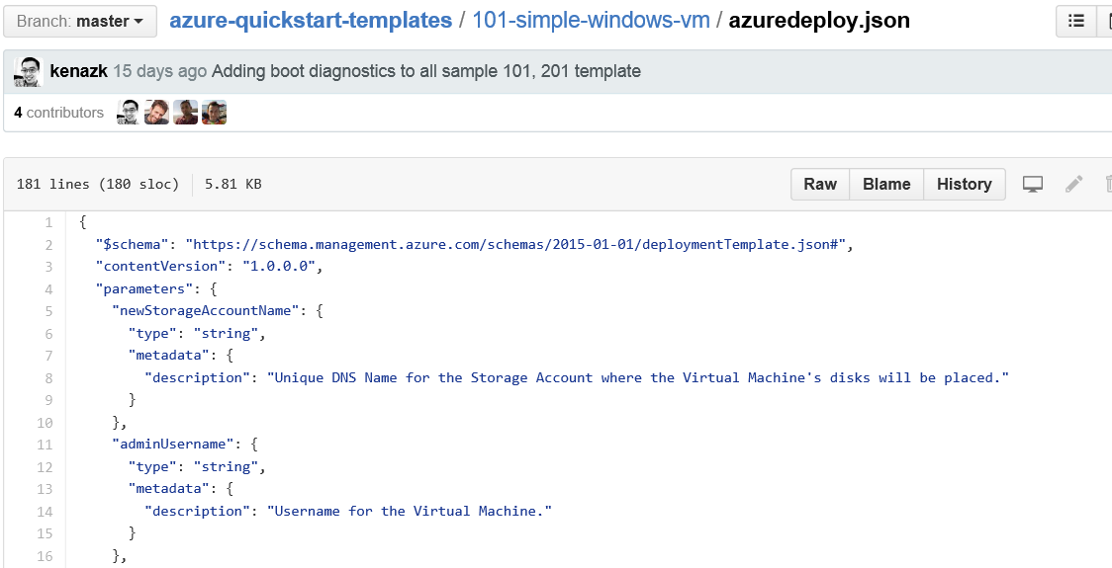
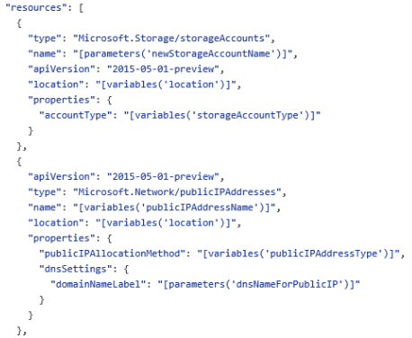
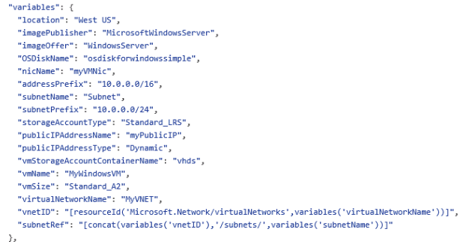
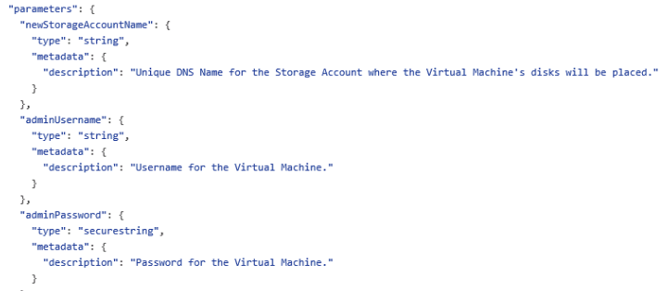
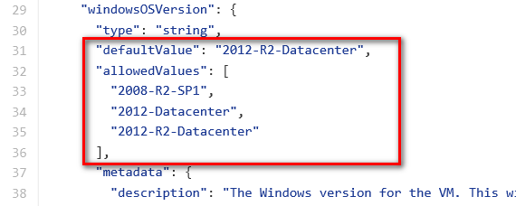
JSON files—simpler than they look Schema, content version, parameters, variables, resources, and outputs

Slide 69


Get started
Visit azure.microsoft.com

